Slide 1
Numerical Linear Algebra meets Machine Learning
Fabian Koffer, Simon Hanselmann, Yannick Funk, Dennis Leon Grötzinger, Anna Ricker
Notes:
Audience Question: What does electrical cuircit design, webpage ranking, portfolio management and quadratic programming all have in common?

Slide 2


Slide 3
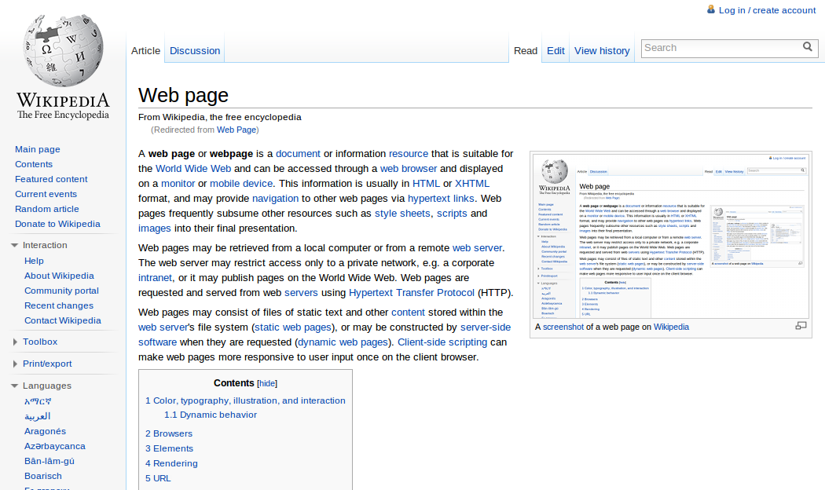

Slide 4


Slide 5
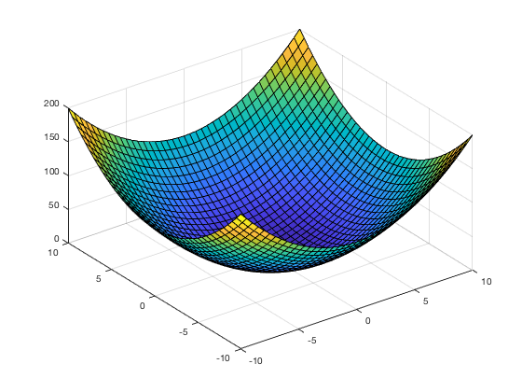
Notes:
Gaussian to slow-> iterative solvers which generate an approximate solution .They will start with initial guess and each iteration will calculate an approximate solution where the result of one iteration is derived from the previous result. The solver will stop if a certain stopping criteria such as a maximum amount of iterations is met.

Slide 6
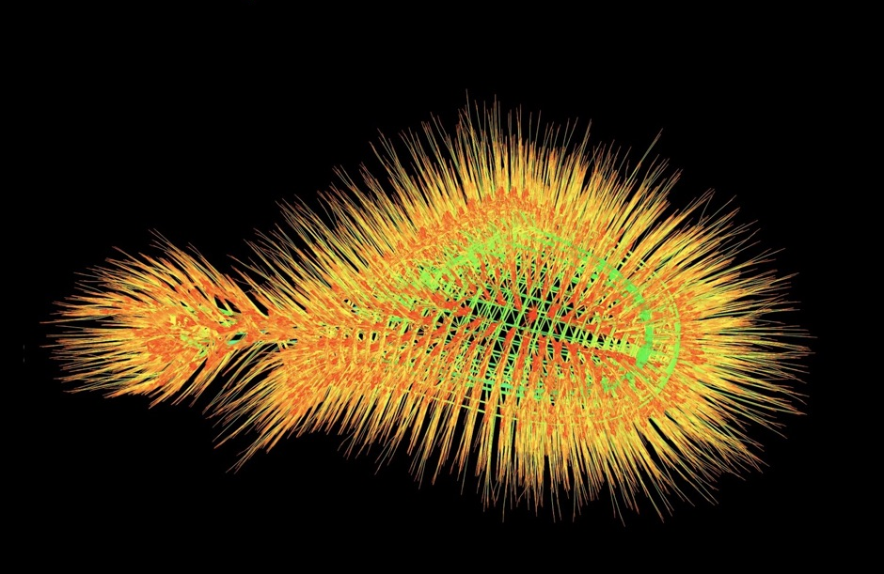
Notes:
To tackle each problem one has to solve some kind of linear systems. And more concretly , one has to solve enormous sparse linear systems with maybe millions of entries and with most entries beeing zero
+ graphical representation

Slide 7
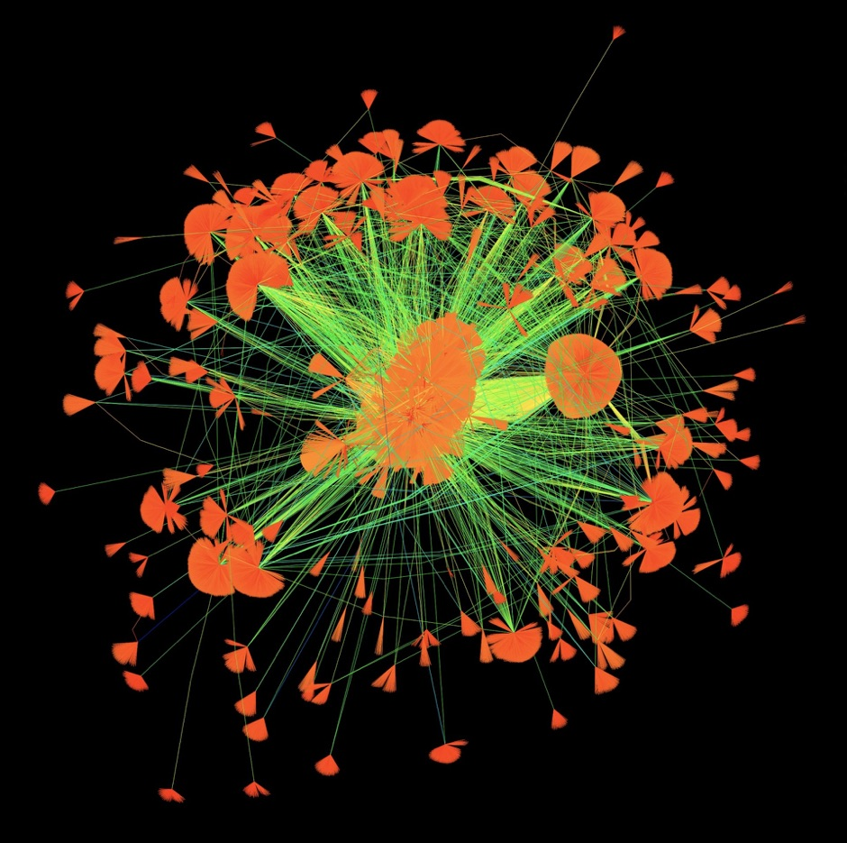

Slide 8
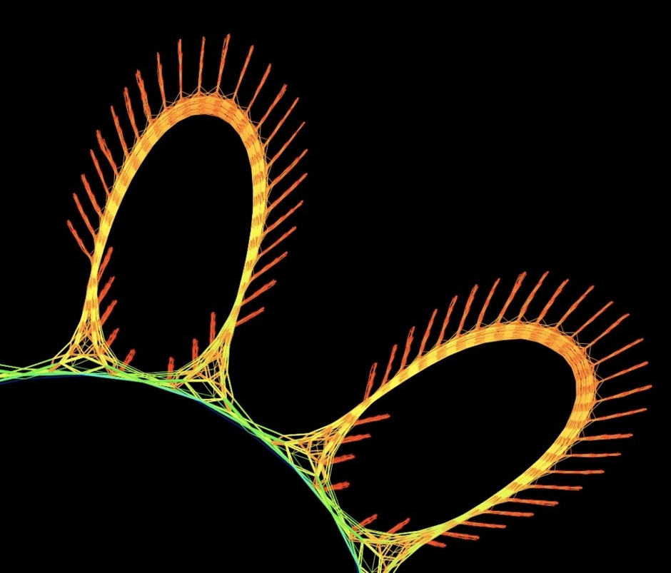

Slide 9
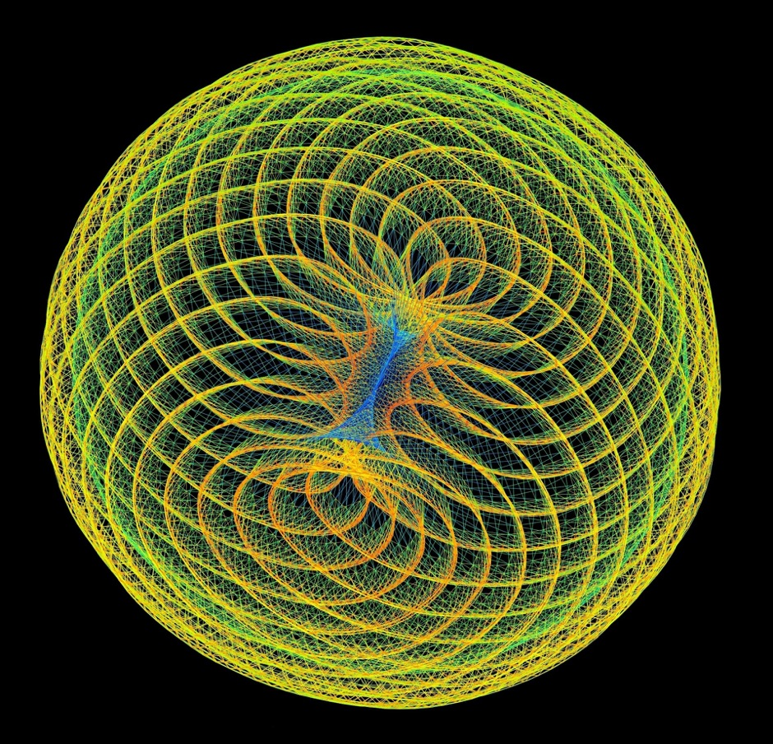
Notes:
Daisy Chain: Financial Portfolio Optimization (2009). Optimizing a financial portfolio leads to a graph with many branches, each depicting a possible future economic scenario. Which path will your portfolio take?
Web Poppies (2009) You like a web page and I like it too. 512 people like 394,792 web pages, do you like them too
reddish-orange frequency-domain circuit simulation matrix constructed via the harmonic-balance method
Convex Quadratic Programming (2009)
But a linear system from one problem might differ substantially from the linear system of another problem like you see here with a cuircuit and …
As a consequence some solvers are more suited to solve some kind of problem and others may be more suited to solve a different kind of problem
But determing which solver will solve a given matrix the fastest might generally not be very obvious. And that is where our software gets involved

Slide 10
Goal: using Machine Learning to determine the fastest iterative solver for a given matrix

Slide 11
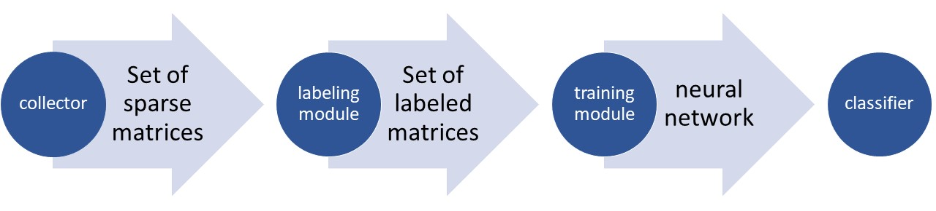
The four components

Slide 12
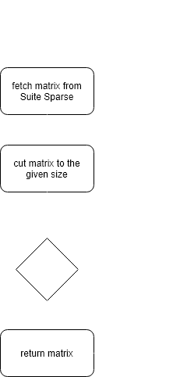
Collector
Tools:
SSget

Slide 13
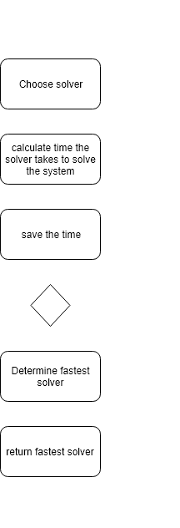
Labeling module
Tools:
Ginkgo

Slide 14
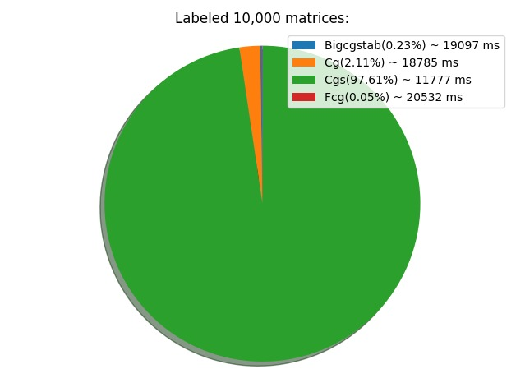
Labeling module
Tools:
Ginkgo

Slide 15

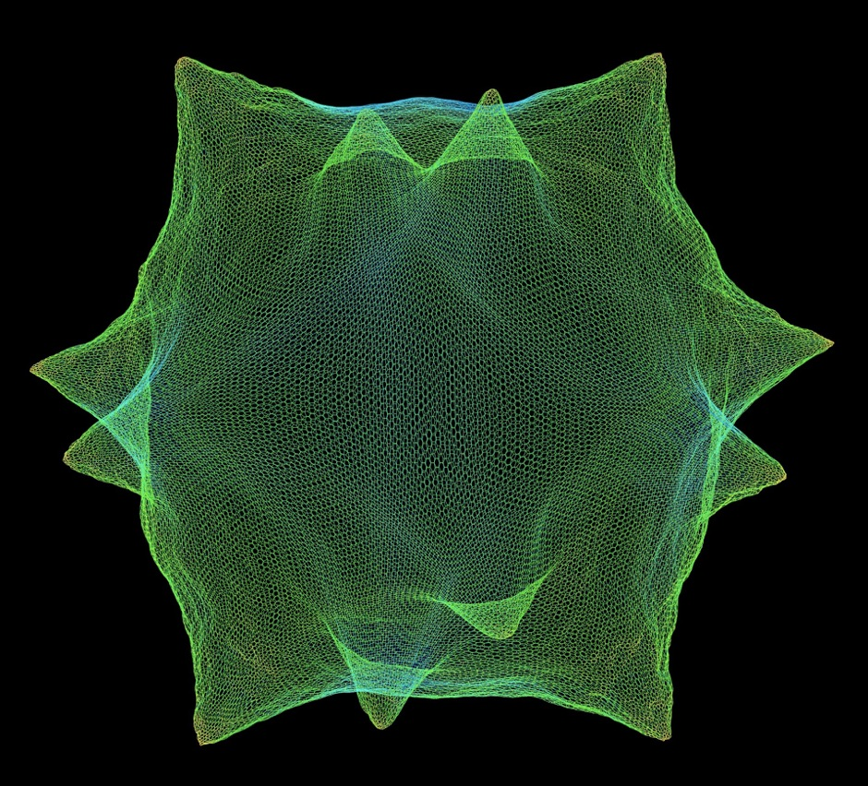
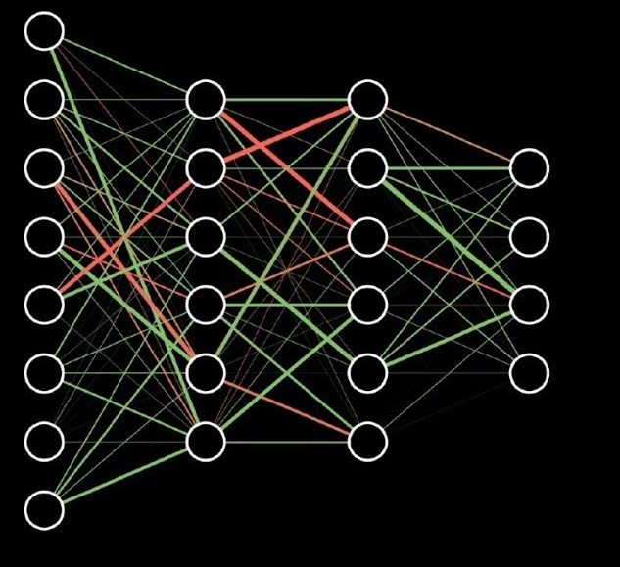
Training module
Fastest Solver

Slide 16
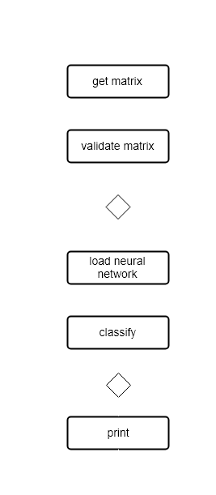
Classifier
Fastest solver

Slide 17
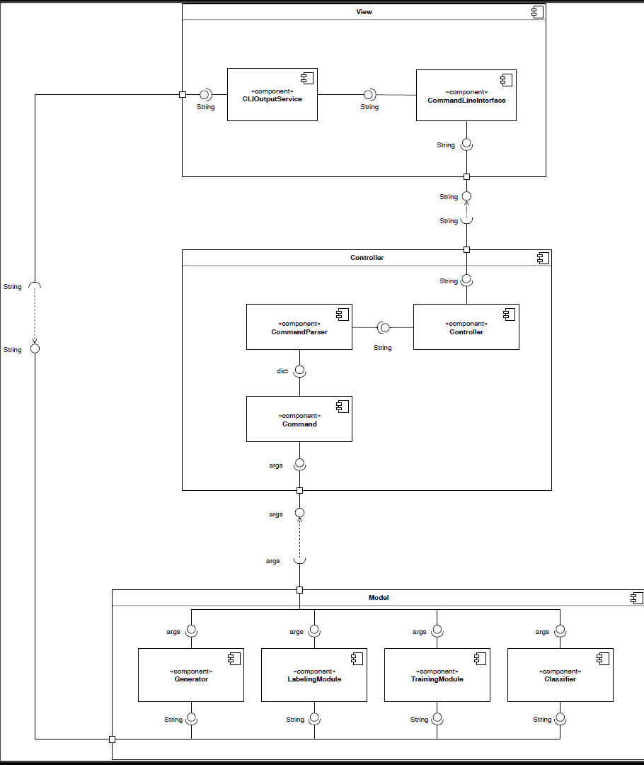

Slide 18
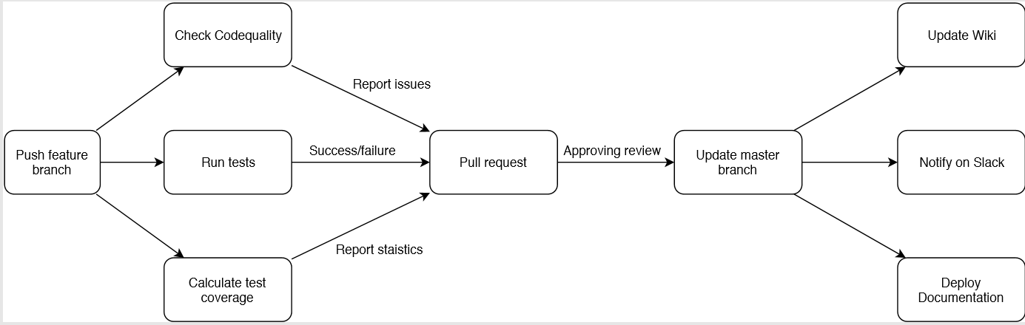
Continuous integration

Slide 19
Challenges
Integrating C++ in python
Ginkgo
Waterfall model is difficult for scientific projects
TDD does not work with NN
Object orientation was difficult
Artificial generating of matrices

Slide 20
Statistics
Lines of code
Python code: 2500
C++ code: 200
others: 200
Commits: 900
Training accuracy: 60%
Number of tests: 63
Unit tests: 51
Integration tests: 12
Test coverage: 96%
Notes:
others= config and build-setup files
Overall. 900 commits

Slide 21
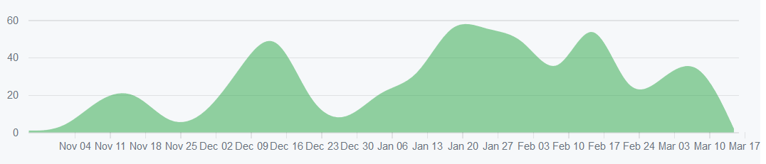
Commits
Notes:
Commit rate increased in January -> start of the implementation phase and quality assurance

Slide 22
Prospect
Analyse data
Add preconditioner
Add web interface
Variable size
Notes:
Following steps:
Data we got out of the labeler to get a better NN
Preconditioner/solver combination
seperate neural networks for each size -> make training independent from matrix size

Slide 23
Collect matrices
Label the collected matrices
Train a neural network with labeled matrices
Classify given matrices based on the neural network

